Slide 1
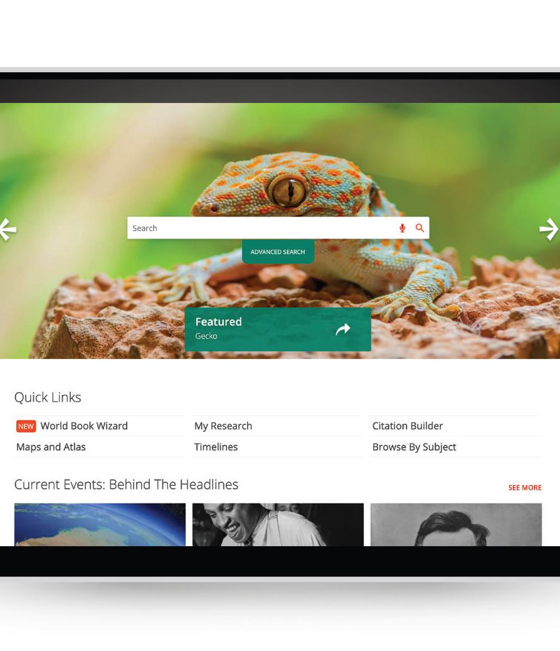


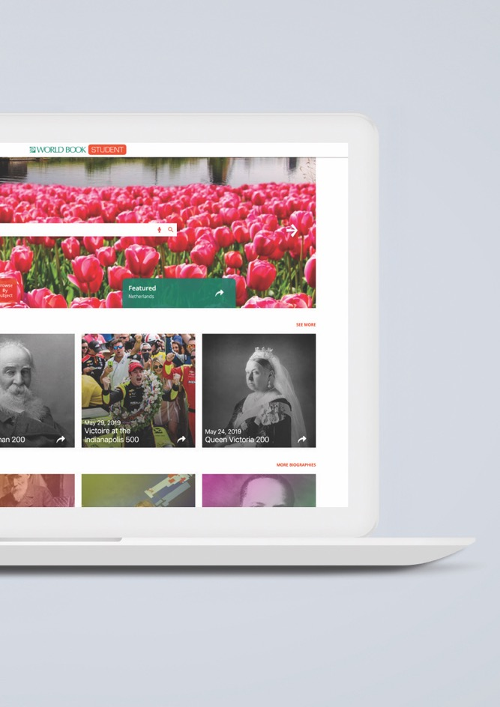
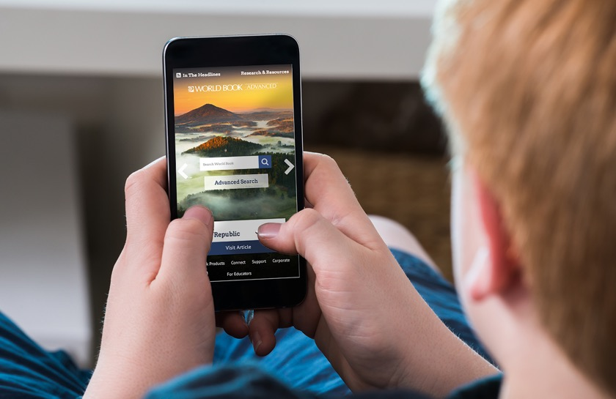


World Book Student
Research • Teaching • Academic Success
Notes:
These slides were provided by and created by World Book. INFOhio added a few directional slides to help users know how to get to the resources and how to learn more through the Learning Pathways Classes.

Slide 2
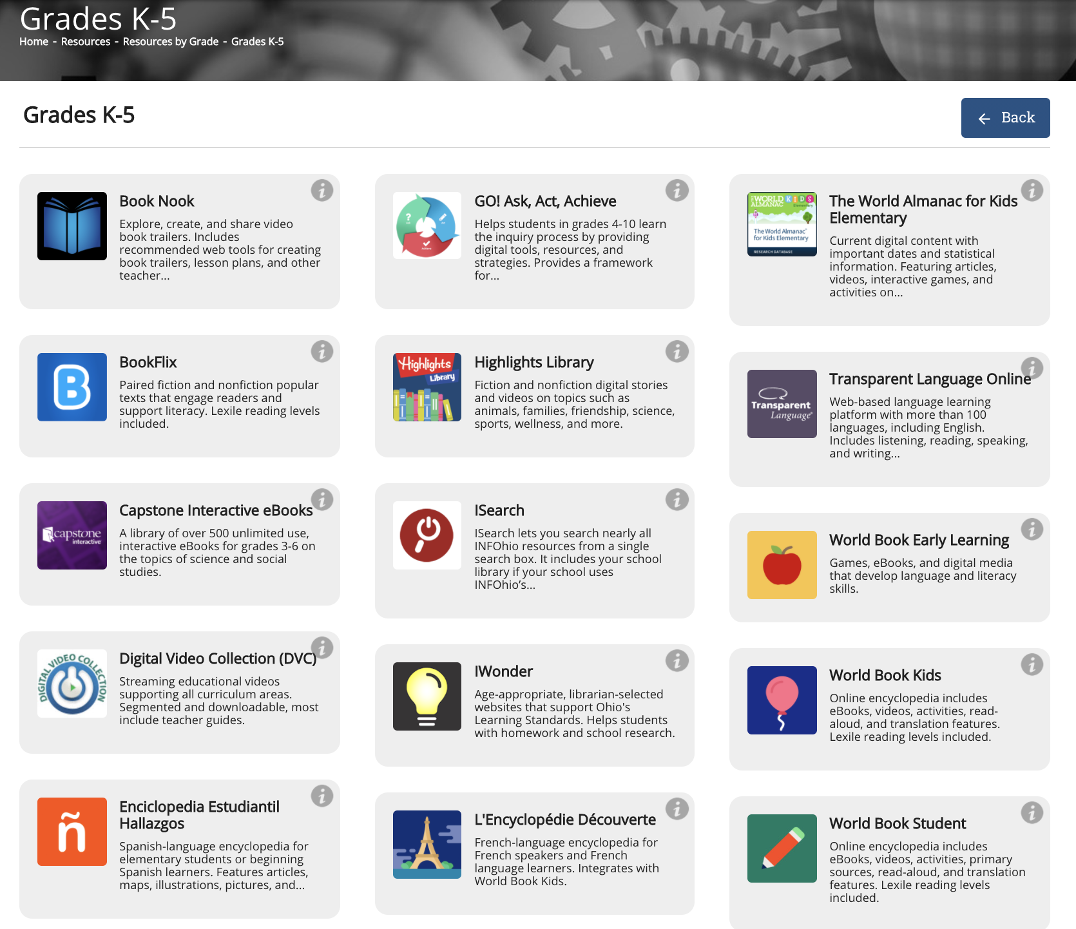

Notes:
*This slide has animation. Use Present mode to view.*
To find the World Book Student resource on the INFOhio website go to the INFOhio homepage: https://www.infohio.org. Click the Grades K-5, Grades 6-8, or Grades 9-12 button. This resource is found in all three of these buttons because it is appropriate for grades 4-10. The i button will give further training and support for the resource, or click anywhere on the resource box to open the resource.

Slide 3
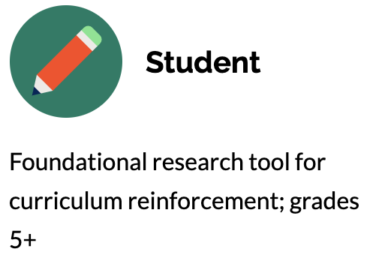
Student
Expansive resource with multiple types of sources, including encyclopedia articles, special reports, images, tables, and more
Research tools, including My Research, a citation builder, and How to Do Research
A current events tool, Behind the Headlines, which summarizes news stories at a reading level appropriate for students and links related encyclopedia articles
World Resources, including an atlas, interactive maps, and the Compare Places feature
Math and Science games appear on relevant articles to engage users and extend learning in a fun, interactive way
The Biography Center contains more than 10,000 biographies
Notes:
For more information/talking points, check here- https://www.worldbookonline.com/training/products/student/student-index.htm

Slide 4



A continuously updated source of student-friendly information
In addition to building foundational skills and supporting the curriculum, you will find current events, and up-to-the- minute updates on important and relevant events.
Behind the Headlines
New and revised articles and media
Continually adding content

Slide 5
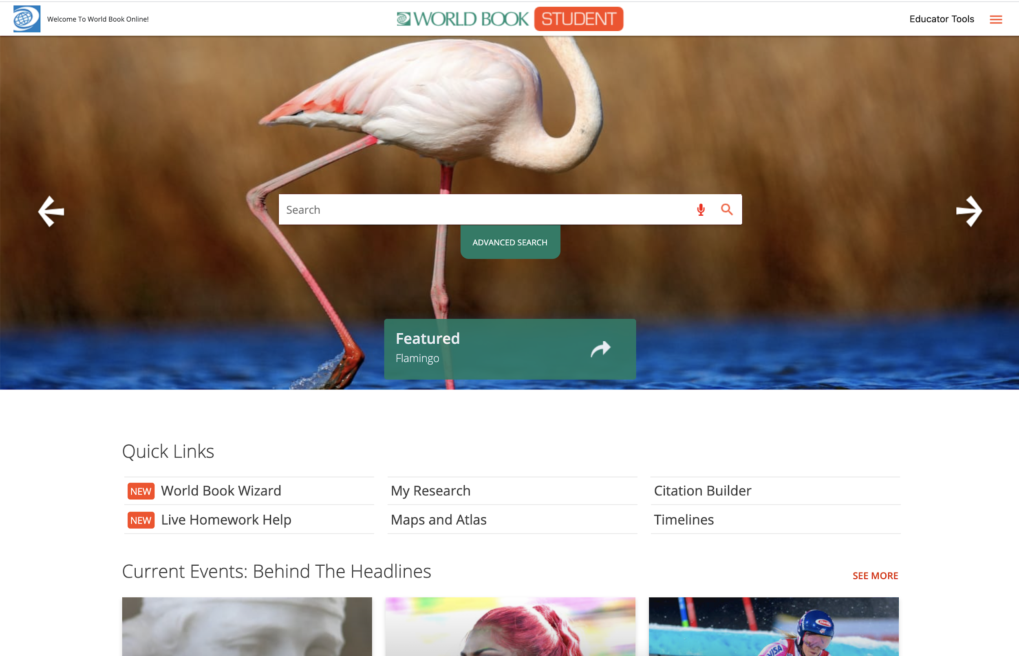
Features

Slide 6
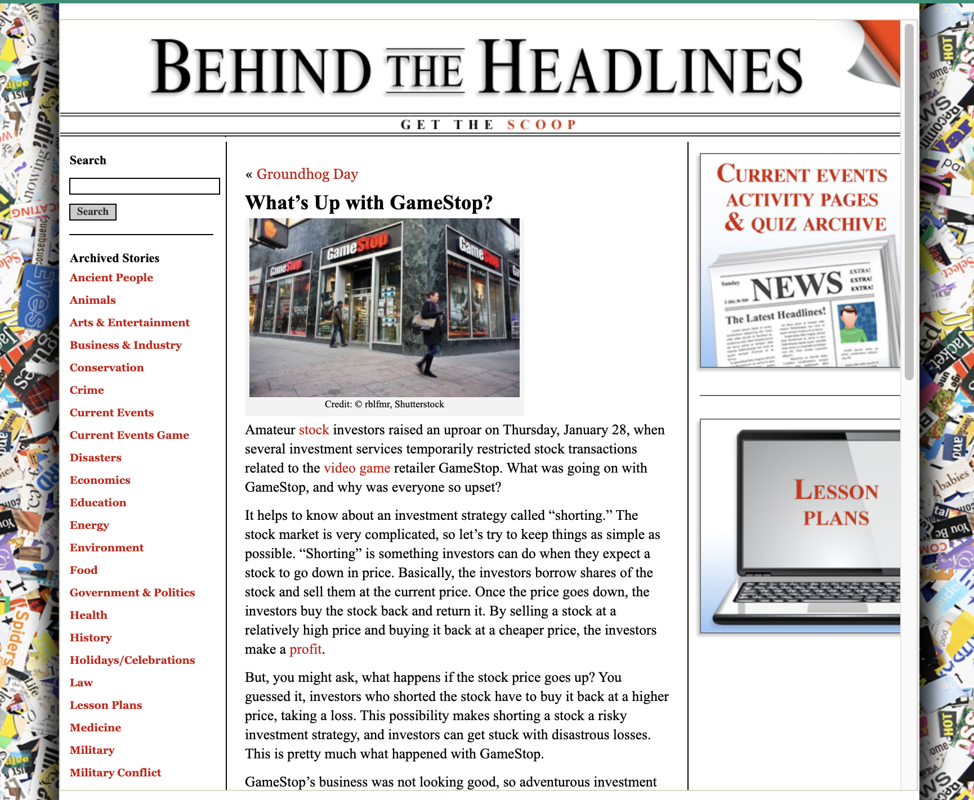
Behind the Headlines
Take current events further with Behind the Headlines!
Released every 2-3 days.
These current events include links to help students build background knowledge and dive deeper into timely topics.
Pair them with a graphic organizer for an engaging active reading assignment.

Slide 7
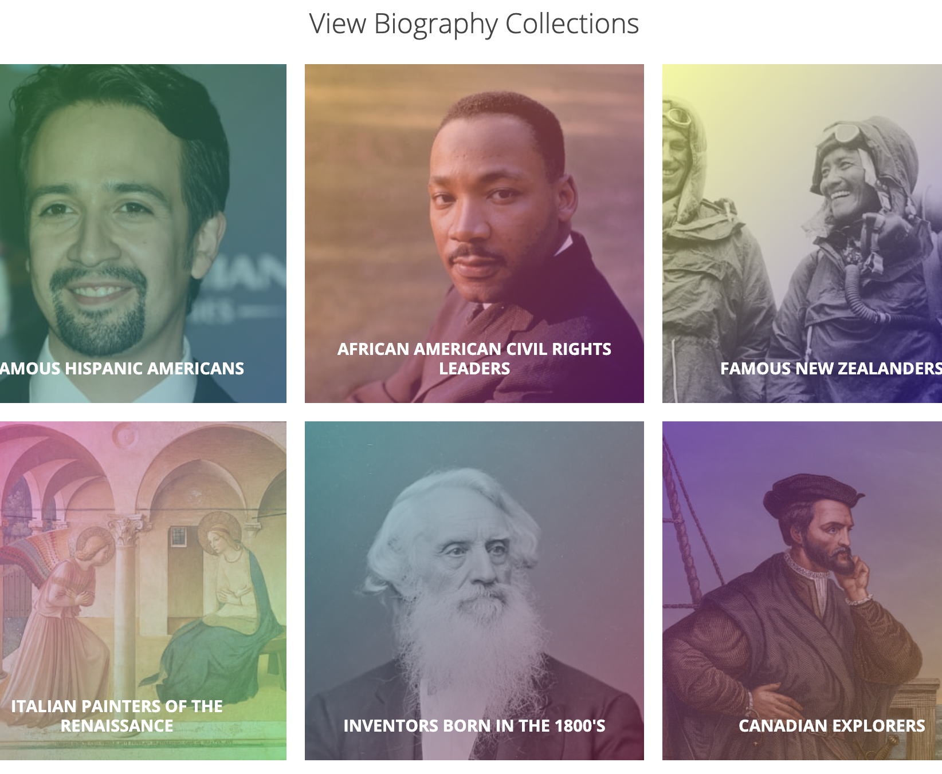
Biography Center
Expand your print collection with over 10,000 digital biographies!
Students can research their favorite icons in one easy-to-navigate section of Student.
Search via text, collection, or use filters to narrow results.
Whether the class is writing reports, studying biographies, or simply exploring, there is a lot to discover here.

Slide 8
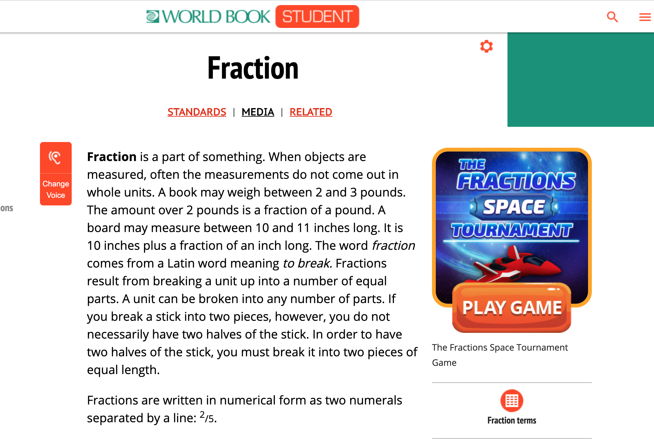
Games
Fun and educational
Tied to relevant Math & Science articles, vetted by our editorial team
Directly on the article or under Media
A full list of games is available on the Training Guide. This comes with vocabulary words and discussion questions.

Slide 9
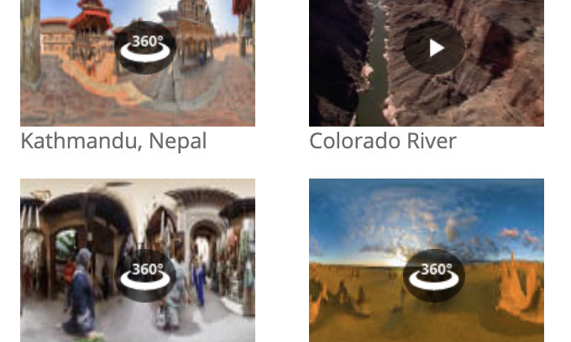
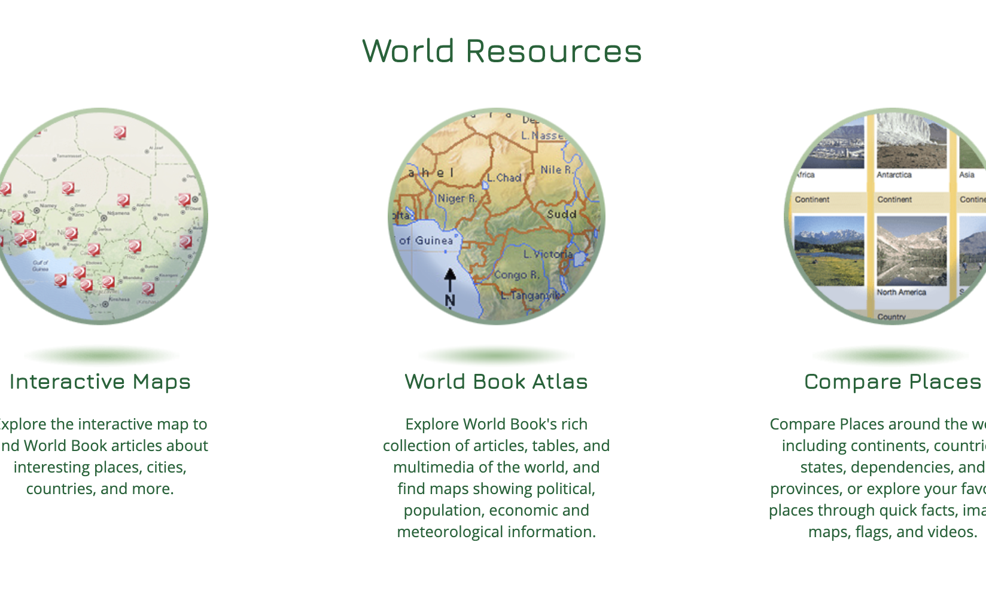
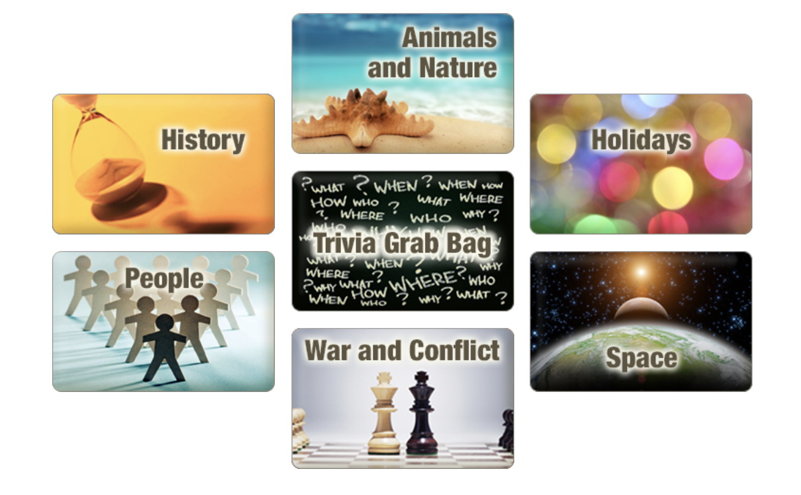
Additional Features
Take a virtual field trip with 360-degree images. Step inside places far away to get a real-life feel for someplace new!
Take a deeper dive through the World Resources features. From interactive maps to a virtual atlas – students can view maps & information in a variety of formats.
Play a trivia game with pre-created trivia quizzes on a variety of topics.

Slide 10
Tools to elevate learning

Slide 11
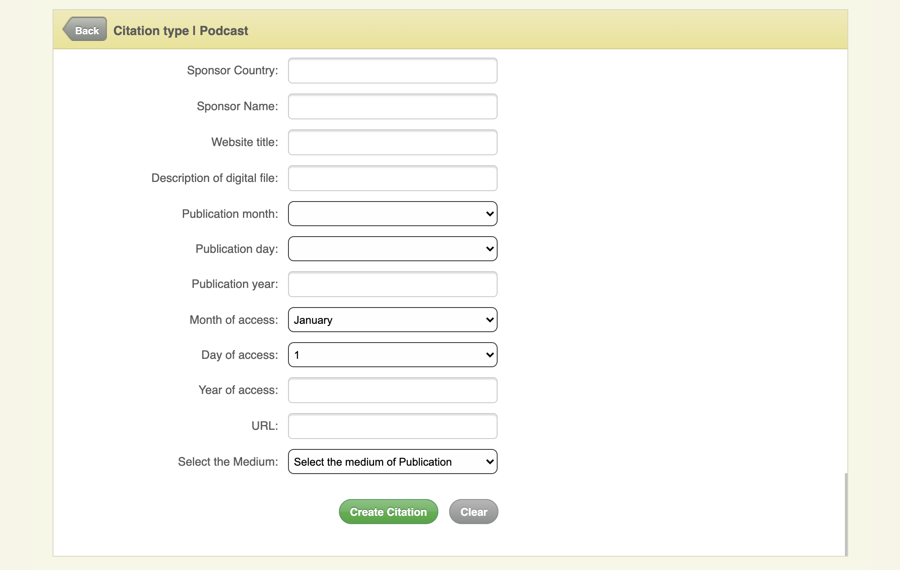
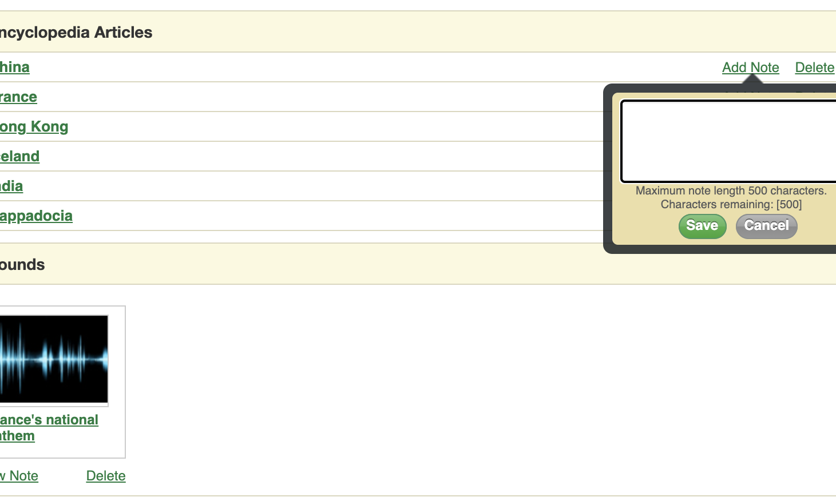
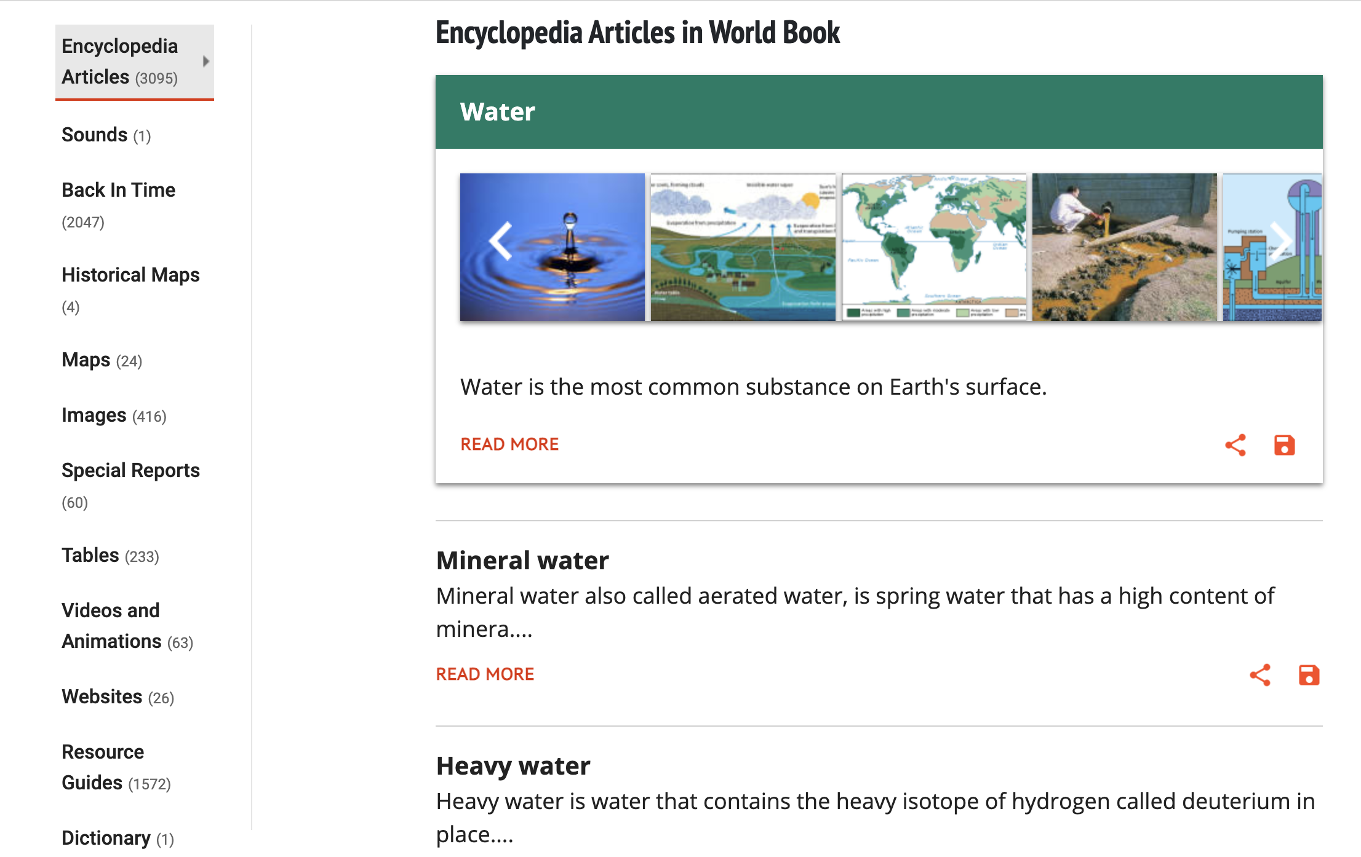
Built-in tools to aid and enhance research
An easy-to-use citation builder that formats sources in MLA, APA, and Harvard format.
The My Research feature provides a way to digitally organize and add notes to sources for projects.
Search results are presented with a variety of source types to meet various learning styles and project needs: read an article, look at pictures, watch a video, or explore maps!

Slide 12
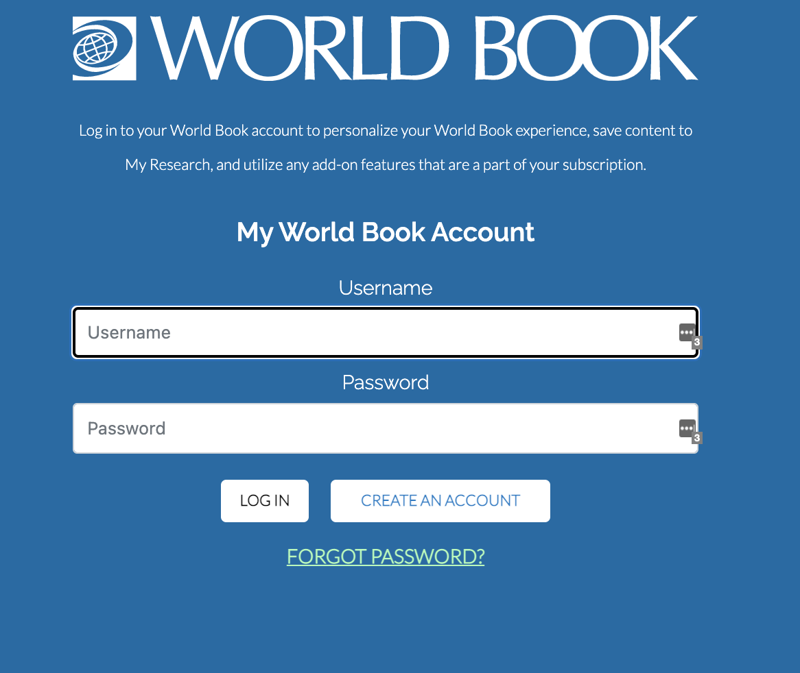
My World Book Accounts
My World Book is a way to personalize your experience by creating a My World Book Account. This is a one-time creation.
With a My World Book Account in Student, you can:
Create My Research projects and save content to them
Save citations from the Citation Builder to your My Research projects
Use add-on features like Live Homework Help & World Book Wizard (if they are part of the account subscription)

Slide 13
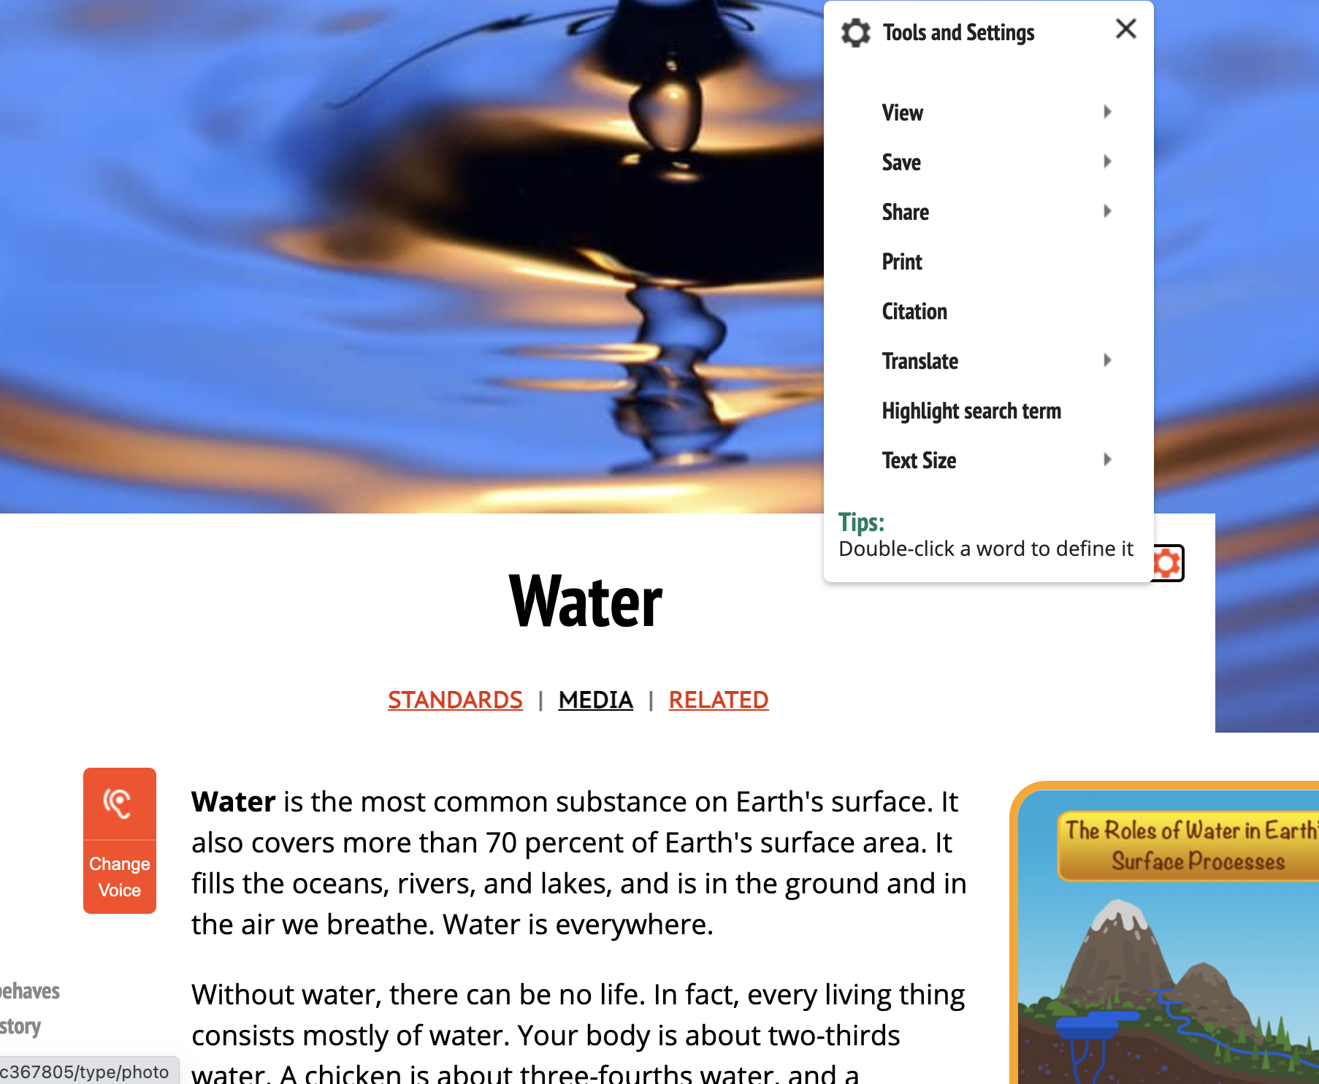
Articles include features to guide learners
The built-in read-aloud function includes a word-by-word highlight while reading to help with pronunciation and understanding new words in context.
Double click any word for a pop-out dictionary definition.
Every article can be translated into over 100 languages.
The media tab offers pictures, videos, and games on some articles.
The Related tab holds links to related articles, sources, and more.

Slide 14
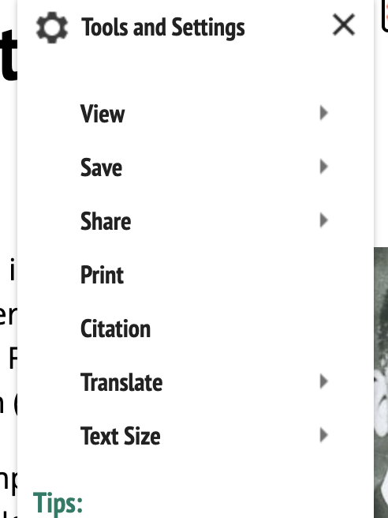
Tools to expand your reach
The Tools section of any article, image, map, and more offer multiple ways to share content.
Print to provide resources for students without Internet access at home. Include multiple sources in a take-home packet to work offline.
Save content to OneDrive or Google Drive for easy collaboration with colleagues.
Translate articles into over 100+ languages
Adjust settings for additional accommodation such as text size.

Slide 15
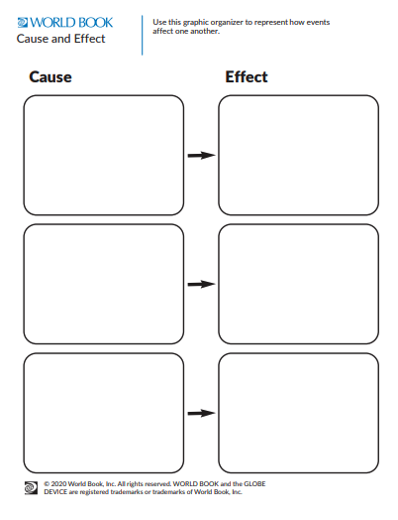

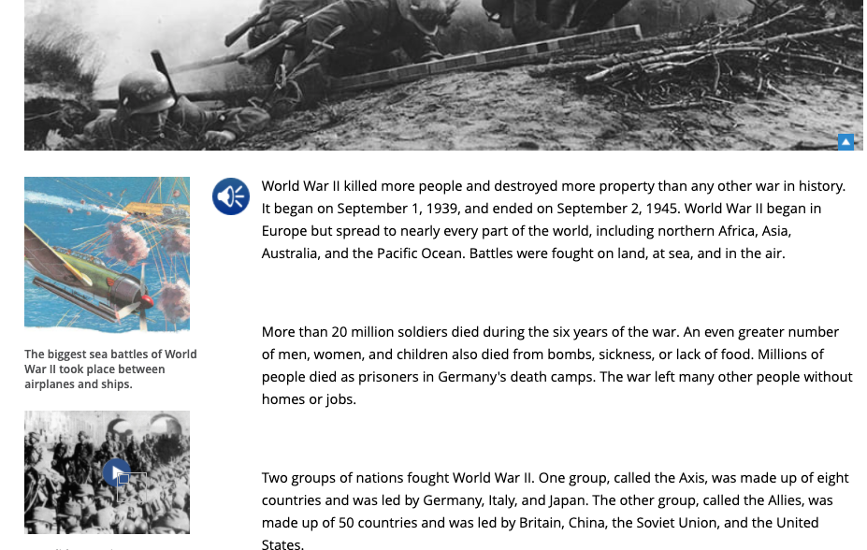
Extend learning with graphic organizers
Pair a graphic organizer with an article or eBook.
Student has 20+ graphic organizers found in Educator Tools.

Slide 16
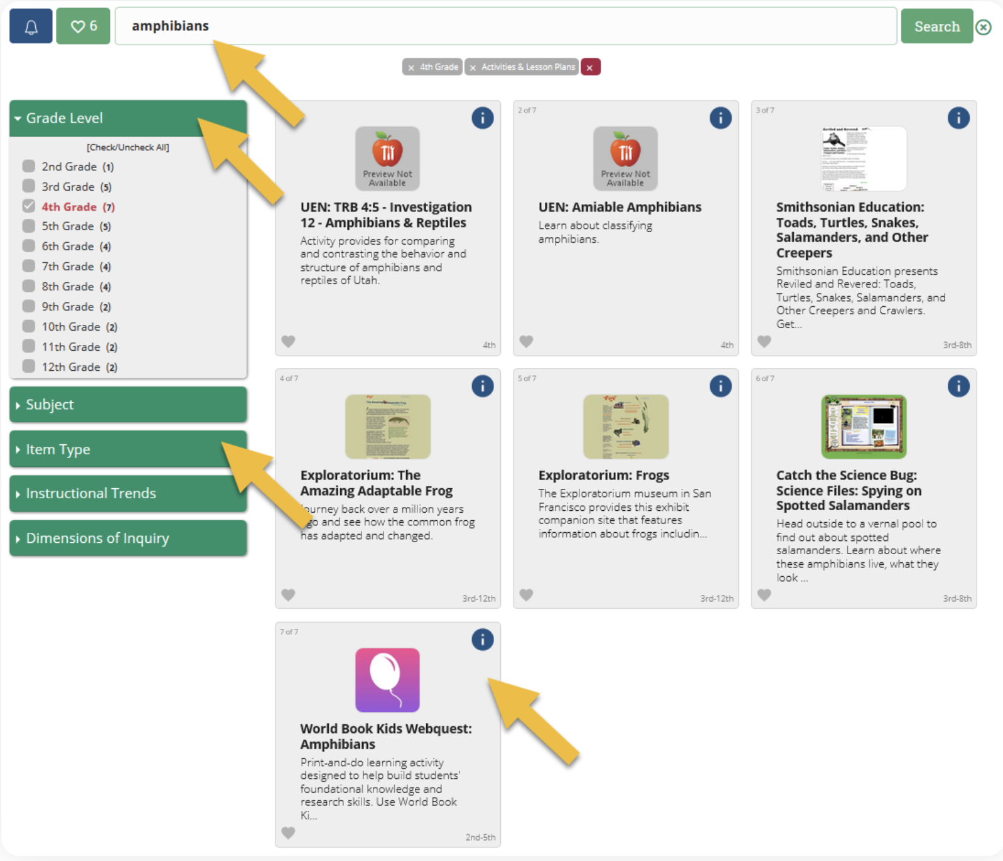
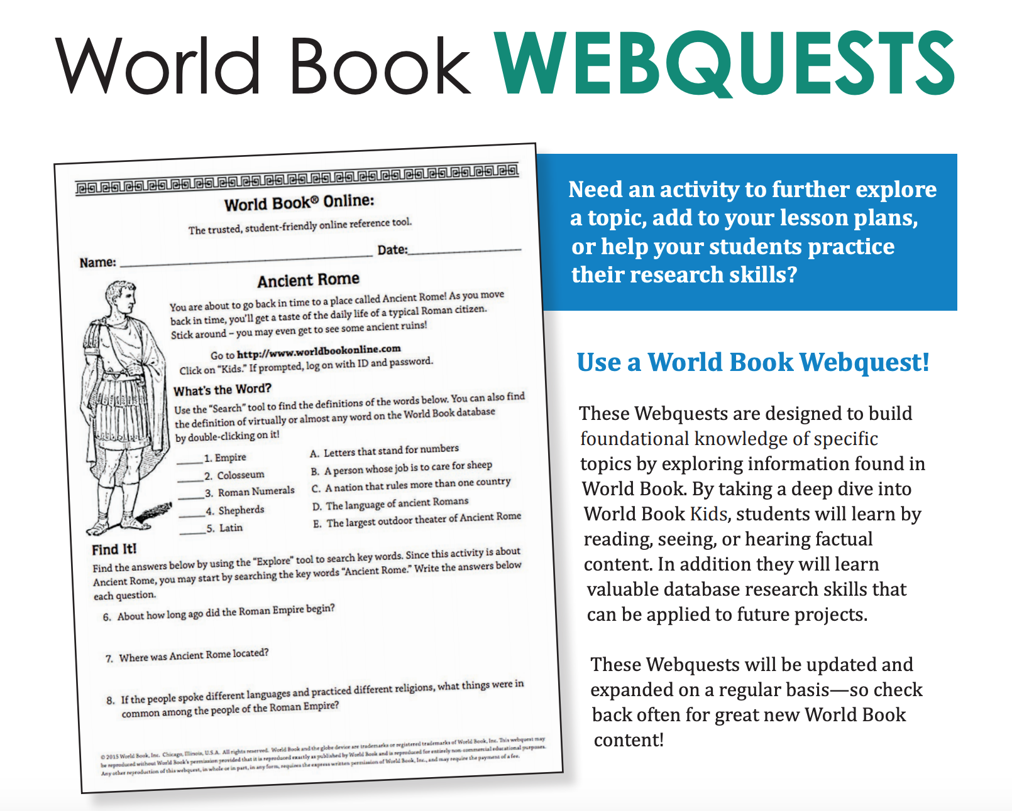
WebQuests
Organized by subject, WebQuests are great for building background knowledge before a unit, as a tool for further information and research, or as an assignment within the unit!
A variety of question types help build students’ comprehension skills and ability to look for information in multiple formats.
Have confidence that students will be successful in their quest because each one is designed to be conducted within the given World Book product.
The teacher page includes an answer key.
Use the Research Skills WebQuests to introduce students to Kids at the start of the year. This quest will lead them through the resource so they are comfortable navigating around and using this on their own!
Find WebQuests by searching in INFOhio’s Educator Tools.
Notes:
Searching for “webquest” or a specific webquest is easy when using INFOhio’s Educator Tools.

Slide 17
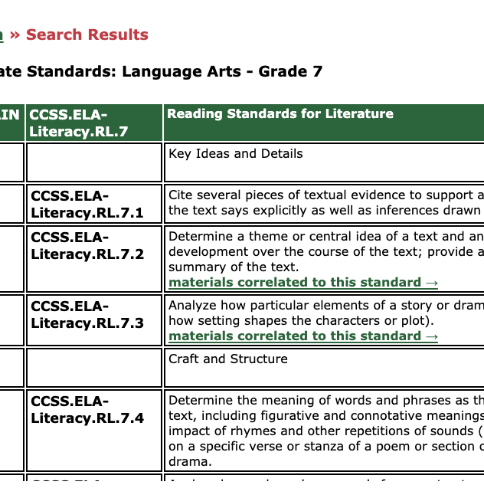
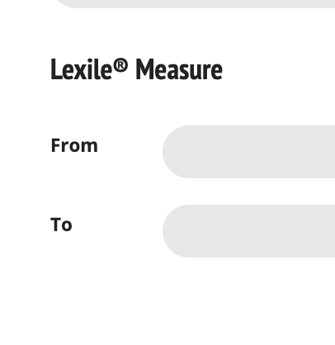
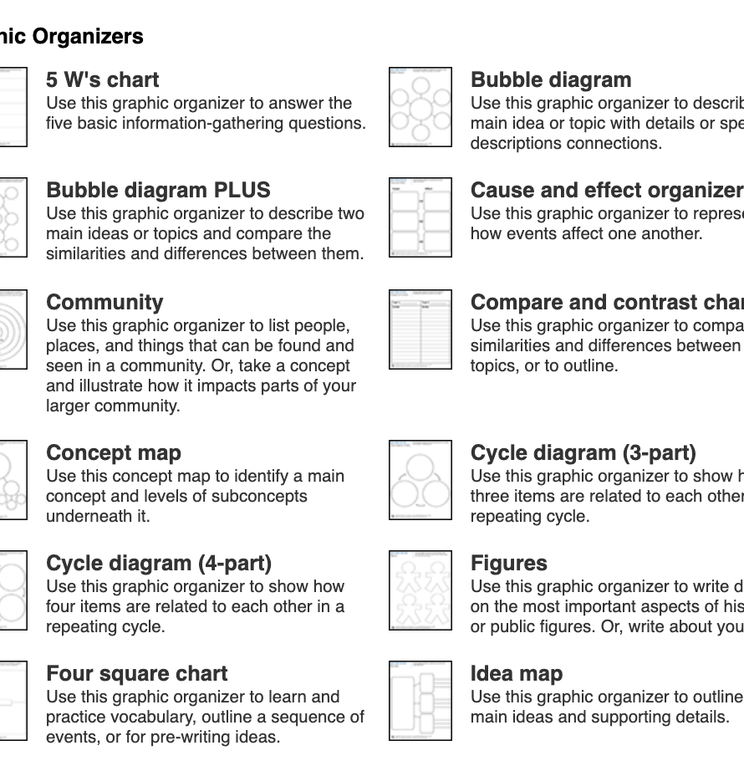
Educator Tools
Search for material by standard
Save time and look for content by learning objective. Use the curriculum correlations feature under For Educators-> Educator Tools.
Pull content from Student to work into platforms you already utilize. Any article can be shared directly with Google Classroom by going to the gear wheel and click Share to Google Classroom.
Lexile Level
Looking for material by Lexile level? Check out Advanced Search.
Graphic Organizers
Access over 20 ready-to-download graphic organizers. Pair these with an article, Timeline, or simply have students pick a topic to research on their own and the organizer can be their guide!

Slide 18
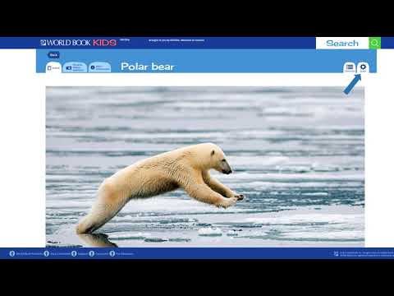
Direct Access to Articles from INFOhio’s ISearch
Notes:
Watch this video to learn how to share articles from World Book Student using INFOhio’s ISearch.
INFOhio’s ISearch: https://isearch.infohio.org, lets you search nearly all INFOhio resources from a single search box.
If you use a platform, other than Google Classroom, articles from World Book Student can also be shared with a direct permalink from ISearch that will work in any learning management system.

Slide 19
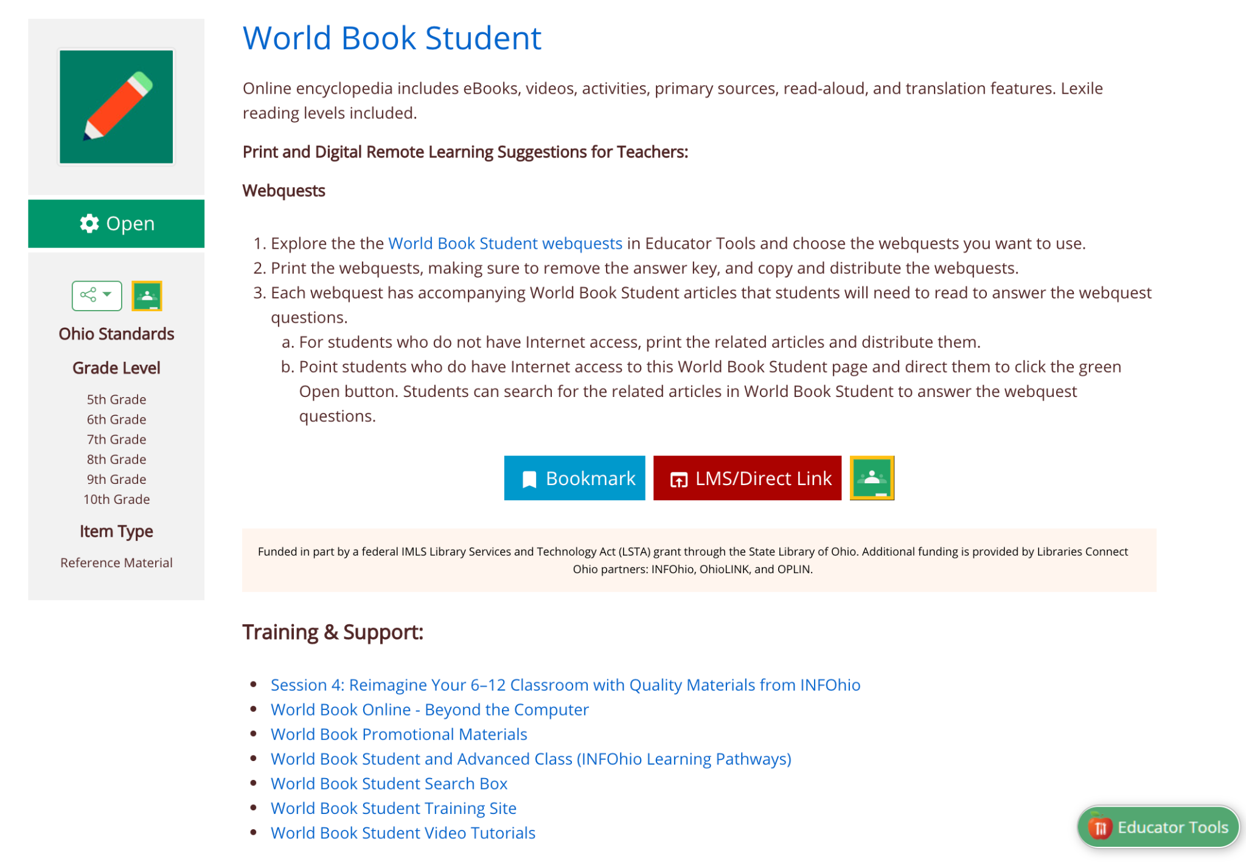
Ideas & Training

Slide 20
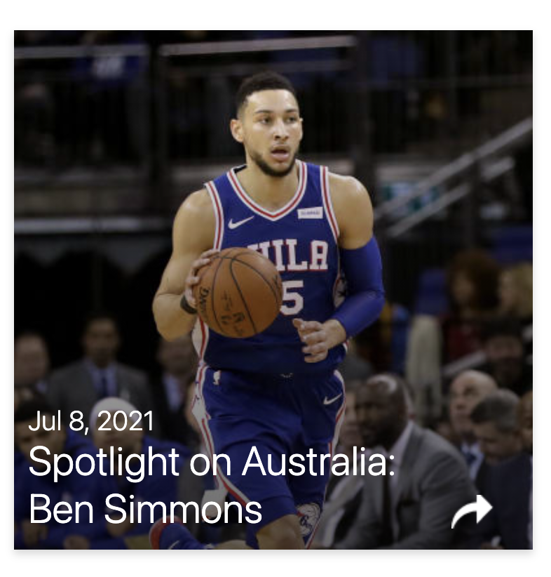
Ideas for Use in the Classroom
Conduct research for call-to-action projects.
Read current events inside Behind the Headlines.
Get citations right every time with the citation builder.
Easily organize articles, media, and citations by topic with My Research.
Received guidance on all phases of the research process using the How to Do Research section.
Learn about important people for a biography or report.
Save media to Google or OneDrive for use in presentations.
Assign content via Google Classroom.
Practice STEM concepts with educational games.
Notes:
For more information/talking points, check here- https://www.worldbookonline.com/training/products/kids/kids-index.htm

Slide 21
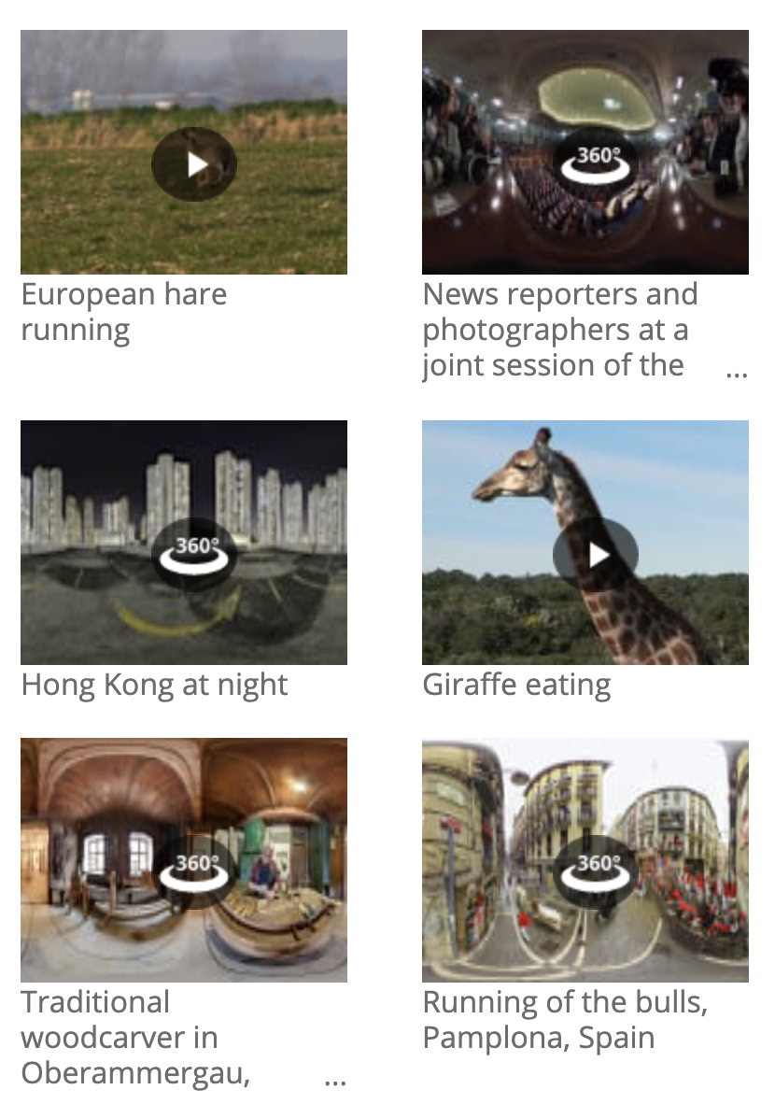
Ideas for Use in the Library
Help students conduct research in a safe, trusted environment
Let users know about the ad-free citation builder
Look up characters, authors, and other items from books you read together
Provide educational games for reluctant learners or as a reward
Direct home school instructors to the Educator Tools section for lesson plans, WebQuests, and more!
Go on a virtual trip with 360 images found under featured media.
Notes:
For more information/talking points, check here- https://www.worldbookonline.com/training/products/kids/kids-index.htm

Slide 22
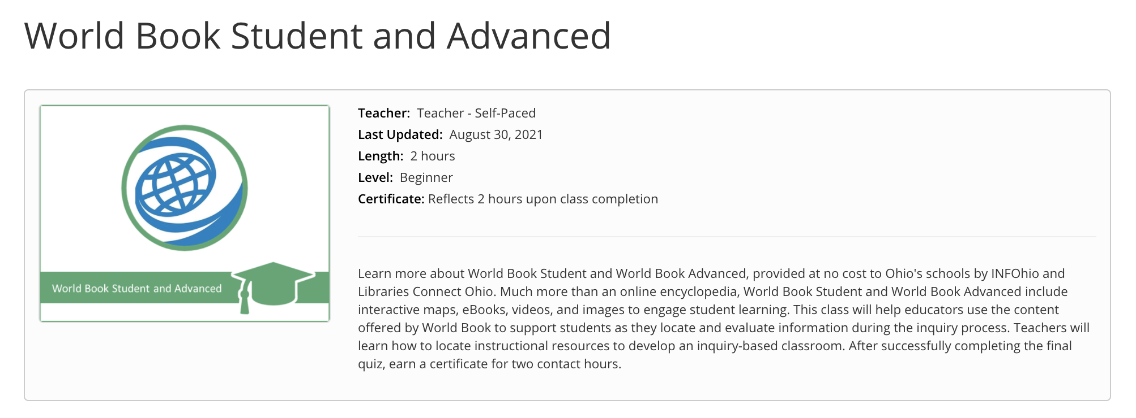
Learn More with INFOhio Classes
INFOhio Campus provides classes to help teachers integrate licensed resources into their classrooms.
Take this asynchronous, self-paced, World Book Student and Advanced Class and earn 2 contact hours after completion of the final quiz.
Notes:
https://infohio.org/campus/learning-pathways/course/world-book-student-advanced

Slide 23
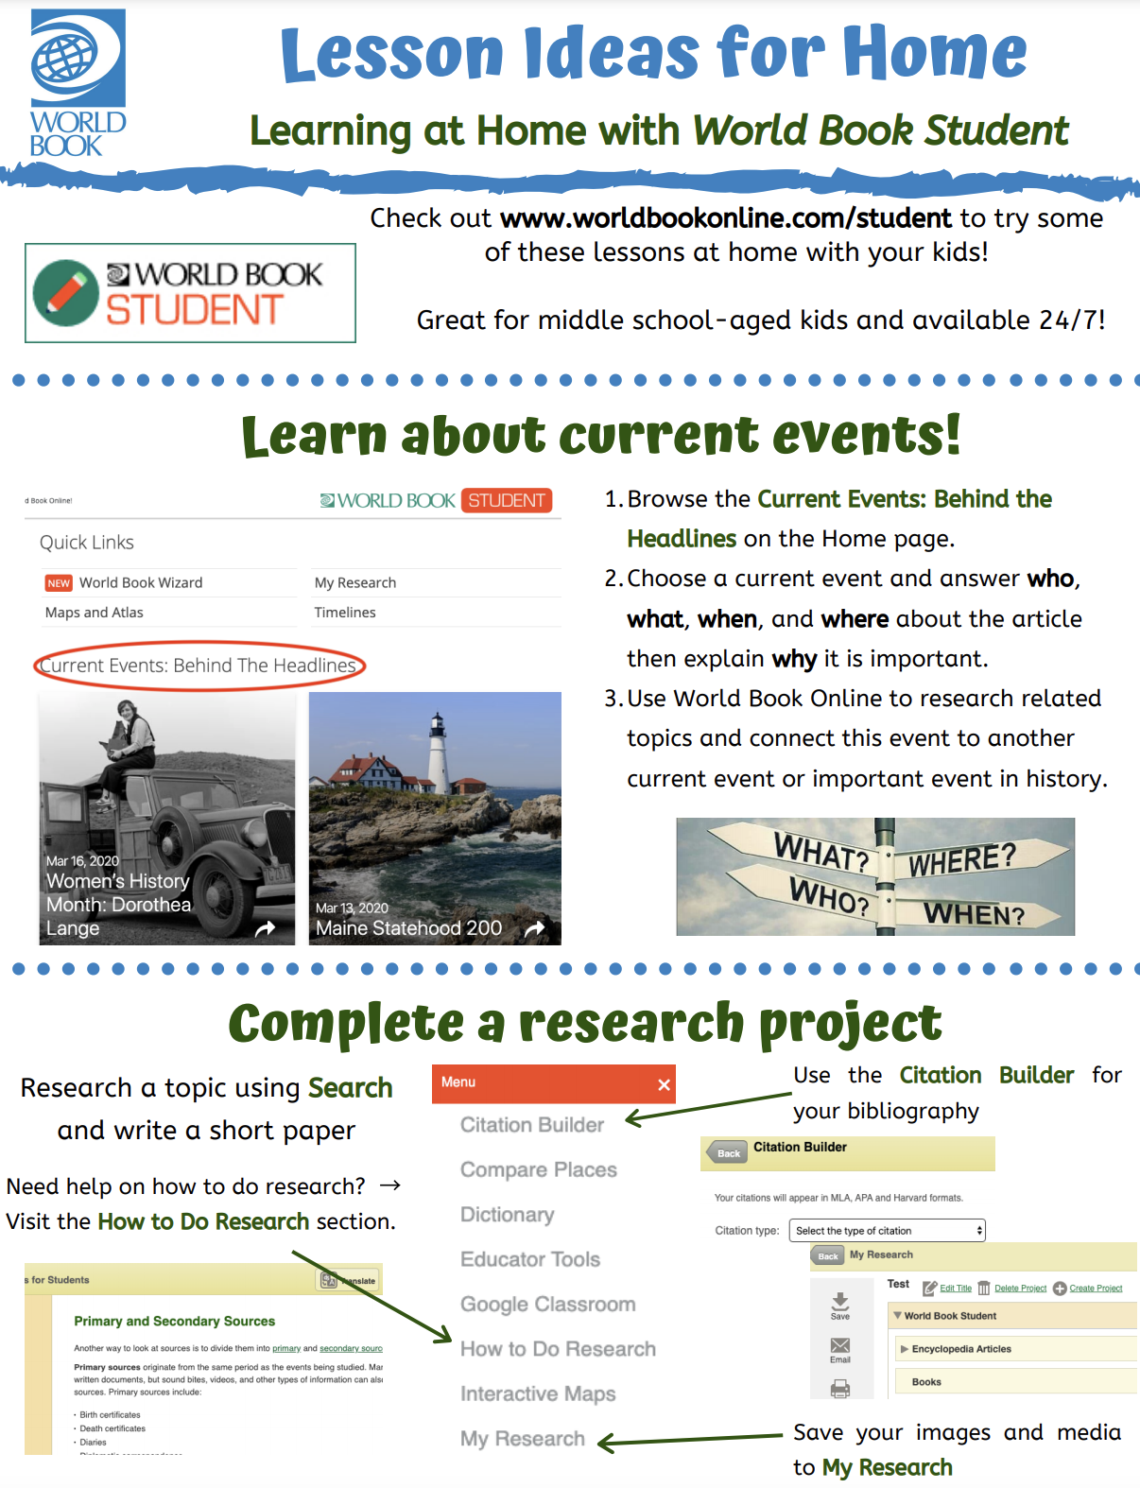
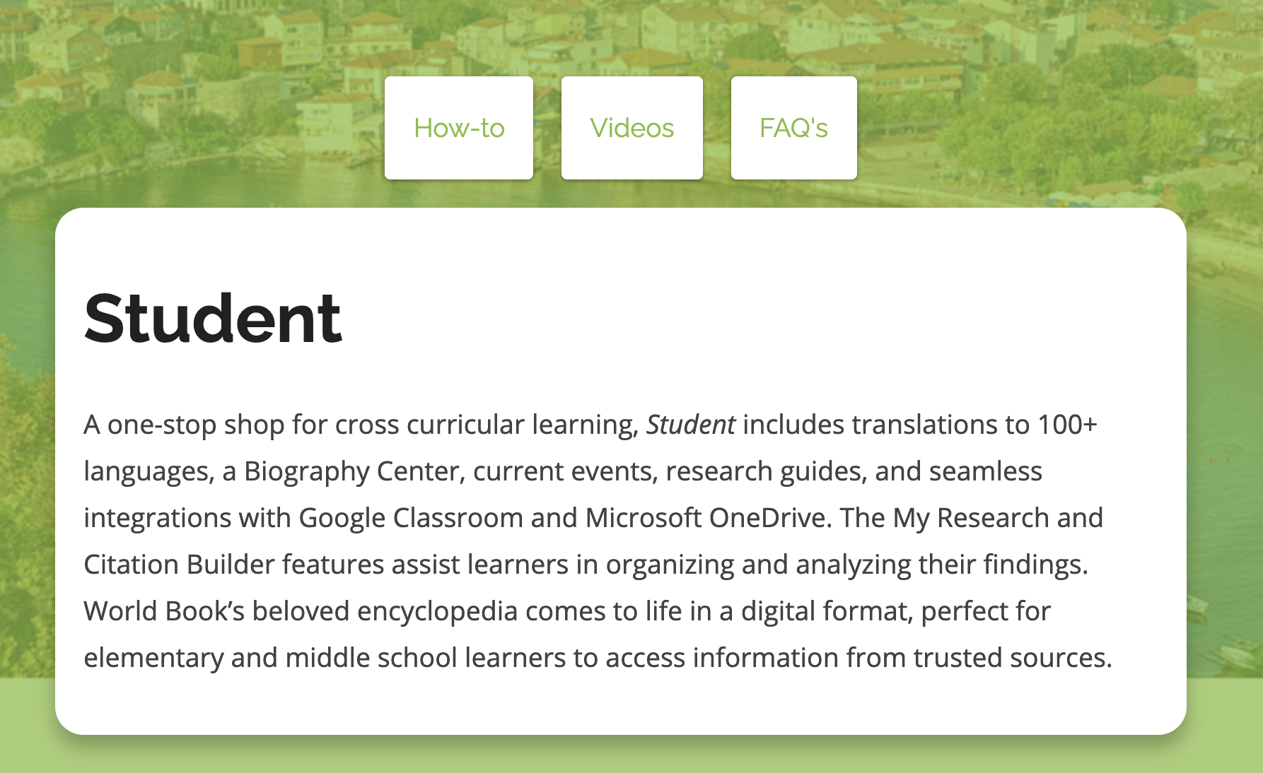

Training Material
Free promotional material such as colorful social media posts, bookmarks, flyers, and more!
How-to articles and tutorial videos on each feature of Student
Ideas for use in the classroom & at home
Resources for students
Notes:
In addition to the INFOhio information page: https://infohio.org/resources/item/world-book-student additional resources can be found here: https://www.worldbookonline.com/training/products/student/student-index.htm

Slide 24
Presented by:
Contact Me!

